Slide 1
Time Management

Slide 2
Freedom, Responsibilities, Needs
You’re Free and There’s Lots to Explore and Do
Events
Organizations
New Friends
But There’s Schoolwork
Assignments
Reading
Homework
Tests
Projects
Papers
Labs
And What about Your Health?
Sleep
Eating
Exercise

Slide 3

Chaos vs. Control
Chaos
Stress
Anxiety
Loss of Control
Missed Assignments/Due Dates
Actions Dis-aligned from Goals
Control
Balance
Timeliness
Stability
Able to Navigate Unforeseen Challenges
More Free Time
Notes:
Student life can descend into chaos very quickly if students don’t manage their time wisely. When students get behind, they can go into damage-control mode, cramming for one exam after the next. Then they don’t learn as effectively, because they’re just hanging on for dear life. It’s important to stay in control by studying for each class, every day. A time management system can help.

Slide 4
Procrastination vs Laziness
Procrastination
-- Avoiding important work by doing something else that requires time, focus, and effort
Cleaning
Organizing
Maintenance
When we’re procrastinating, we’re avoiding getting something done for a variety of reasons we’ll get to in a few slides
Laziness
-- Avoiding important work by doing nothing or doing something utterly vacuous or that generates little long-term reward.
Sleeping
Watching TV
Playing Video Games
When we’re being lazy, we’re just not willing to exert the effort it takes to get something done. That’s a lack of motivation
Notes:
In addition to trying to balance lots of responsibilities and activities, procrastination can undermine success. It’s important to recognize the difference between procrastination and laziness.

Slide 5
Why Do We Procrastinate?
Self Doubt
Low Frustration Tolerance
Hostility (Toward the Professor, the Institution, Education in General)
Psychologists now attribute most procrastination to anticipation of—and protection from—potential negative emotions associated with carrying out the work:
  while doing the work -- boredom, anxiety, frustration, resentment, inadequacy and fear;
  after the work is finished and assessed for quality -- self-criticism, embarrassment, frustration, uncertainty and inadequacy
Notes:
Most of us are at least occasional procrastinators. Students who are chronic or severe procrastinators need to take the instruction here more seriously and you may want to meet with an SCS counselor or ASC academic coach. Regardless, though, start by understanding the roots of procrastination.

Slide 6
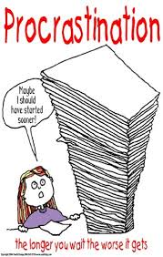
How Can We Overcome Procrastination?
Recognize when we’re procrastinating
Use positive self-talk
Break up large projects into smaller, more manageable tasks
Start with the easiest parts of difficult tasks
Recognize that learning and academic projects are difficult
Know that all projects are relevant
Build in rewards for doing work

Slide 7
Attention Management
In addition to scheduling time to get work done, we also need to manage our attention and focus so that when we’re working, we’re working.
To aid in focusing on what we need to get done, we don’t just think about what and when we want to get something done, but also why we want to get it done.
If we understand why we’re doing something, we’re more likely to be able to focus on it.
Notes:
New research has led to claims that time management should really be thought of as an “attention management” problem. When we sit down to work on a project, our challenge is to focus our attention on the work.

Slide 8
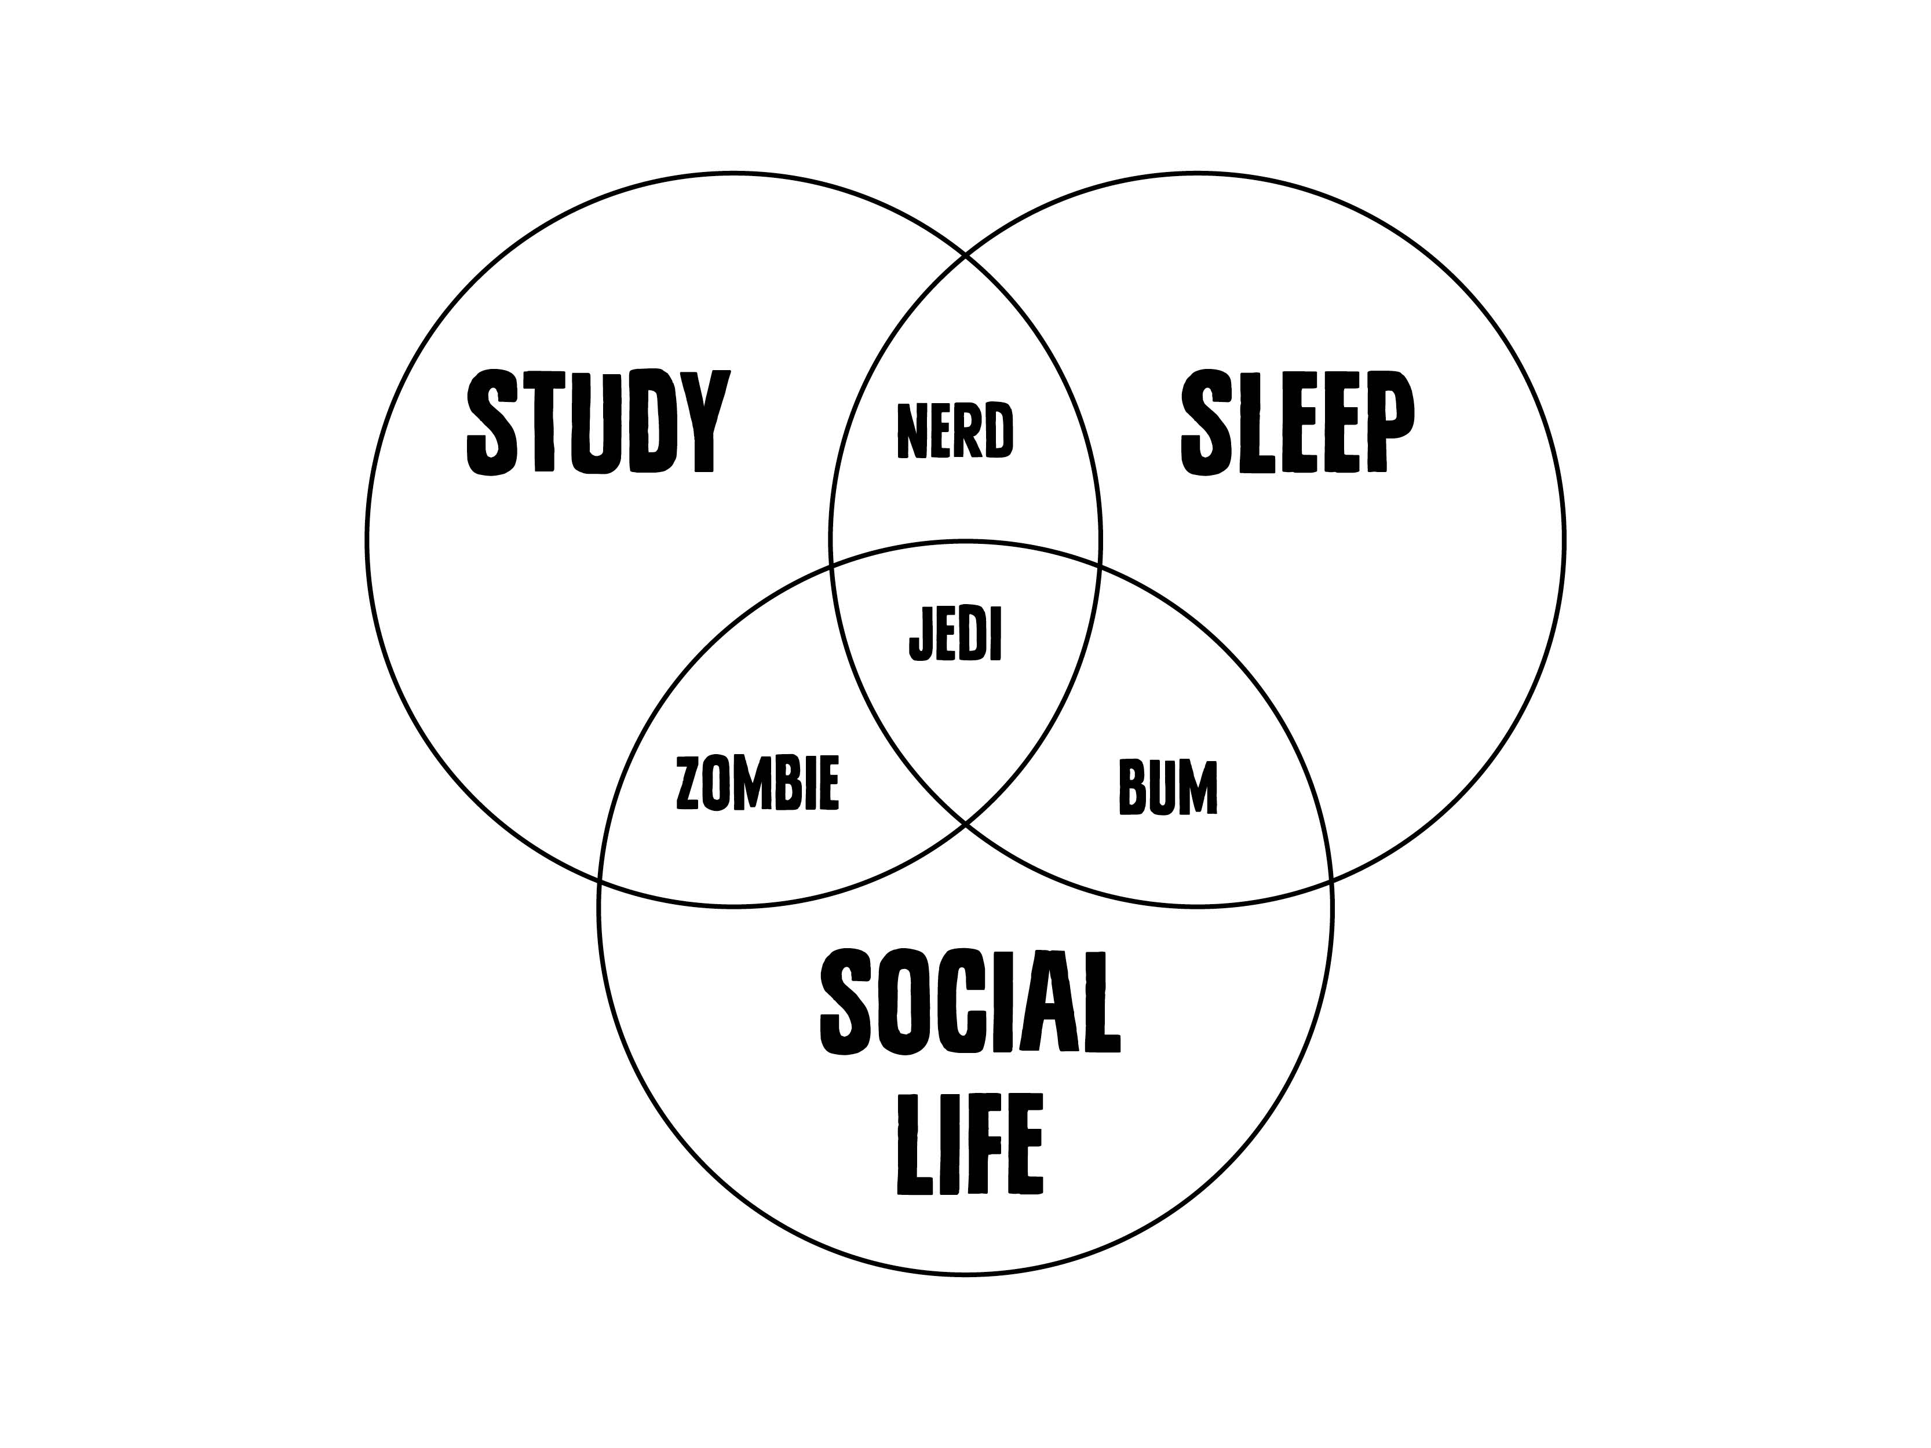
Balance—Your Key to Success

Slide 9
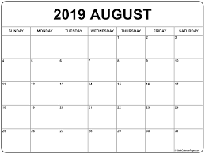
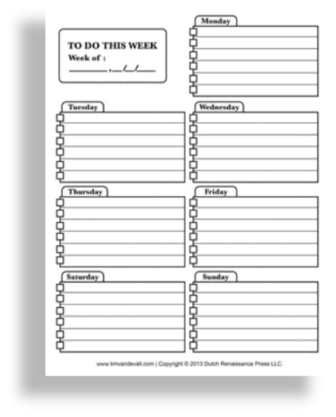
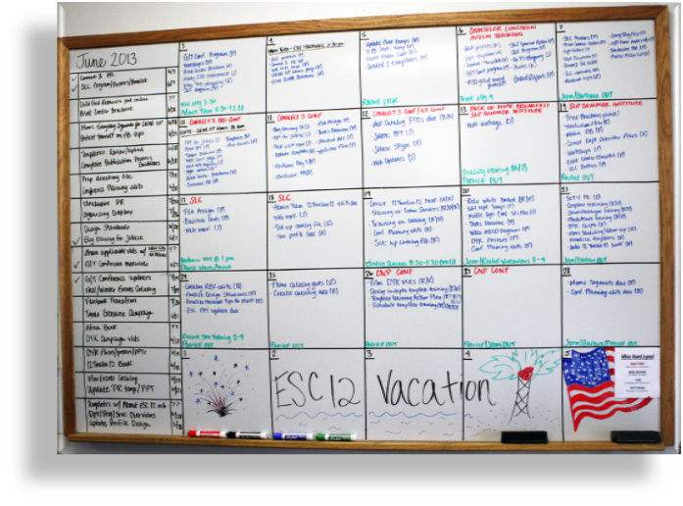
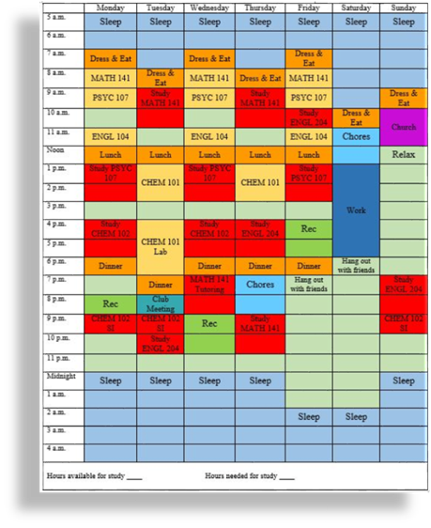
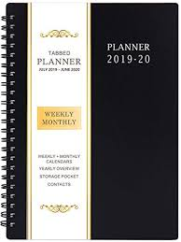
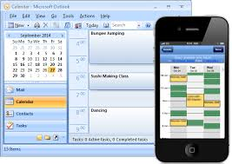
How Do You Stay Productive and Find and Maintain Balance? Make a Schedule
Planners
Semester Calendars
Outlook
Weekly Calendars
Fixed Commitment Calendars
To-Do Lists
Syllabus Matrices
App
Whiteboard
Countdown to Finals
Find what works best for you!
Notes:
We’re not all the same, so there isn’t a planner or calendar that works for everyone. Stess that students must experiment to find what works best.

Slide 10
How Much Study Time to Schedule
As a rule of thumb, faculty and advisors recommend students spend AT LEAST two hours studying outside of class for every credit hour. That means students taking 12 hours should schedule AT LEAST 24 hours of study time.
In reality, average students report spending about one hour studying for each hour they’re in class*.
Either way, successful college students study way more than they did in high school.
If you are scheduling study time, start with two hours per hour you spend in class, for every class.
Use perceived “down time” wisely. Even in weeks without deadlines or tests, stay on top of your work. Studying everyday is the best way to learn and helps avoid exhaustion and burnout during those inevitable busy weeks.
*National Survey of Student Engagement
http://nsse.indiana.edu/NSSE_2011_Results/pdf/NSSE_2011_AnnualResults.pdf#page=16

Slide 11
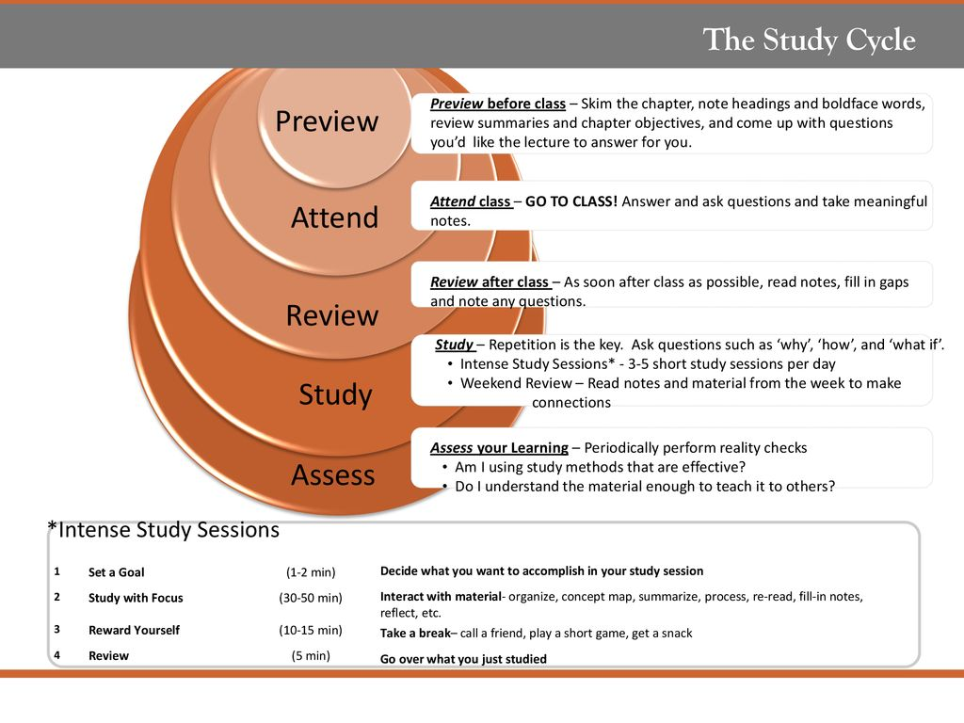
Study Cycle (Important to consider when making a schedule/calendar)
LSU Center for Academic Success

Slide 12
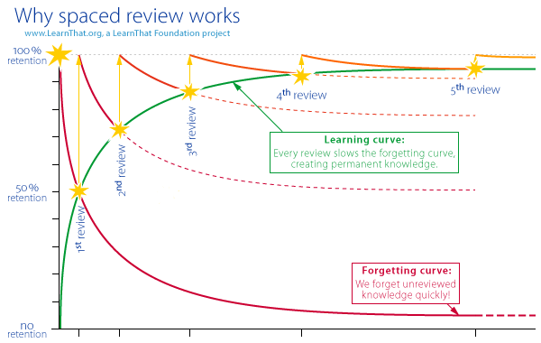
Forgetting Curve and Spaced Learning
Research in cognitive psychology reveals that we forget about 70% of received information in 48 hours.
That means the best way to learn something is to review it as soon as possible after class. Review helps us encode and store information in long-term memory.
We can begin to space out review sessions over increasingly longer intervals after a day or two.
This is a learning approach that is far superior to cramming for exams.

Slide 13
Interleaved Study Sessions
Interleaving is when you alternate between subject or mix up content during a study session, as opposed to studying the same thing or types of content for long blocks of time. If A, B, and C represent content, interleaved study would mean you study in an ABCABCABC pattern instead of AAABBBCCC. It could also mean that you alternate study between Math, Chemistry, and History every 30mins to an hour instead of studying Math, then Chemistry, then history in 3 hour blocks each.
Benefits:
Avoid burnout
Better retention in long-term memory
Gives your brain time to process
Higher efficiency because large blocks of study time are more susceptible to distraction

Slide 14
Time Management Mastery
By scheduling your time, you are working to make the rules you set for yourself second nature. Once that happens, you’re a master student.
Following your schedule doesn’t require so much self-discipline
You’ve made regular studying a part of your routine
You have the flexibility to adjust and stay on top of your work if things come up
You are less tired, less burned out, less overwhelmed and more in-control than many of your peers

Slide 15
Final Tips
Establish a routine. Schedule time to study for every class every day. Learning happens by repetition.
Make time to preview before class and review after
Schedule study time in one hour blocks
Alternate subjects often rather than bingeing on one class
Make time for exercise, fun, entertainment, health, leisure, and sleep
Find study times that work best for you

