Slide 1
The Academic Success Center (ASC) Top 10 Tips for Academic Success
Notes:
You can delve deeper into the topics covered in this presentation by looking at related topics in other lesson plans.

Slide 2
Who the ASC is and what they do
Mission: provide comprehensive resources that help all Aggies achieve their academic goals
The ASC provides a variety of academic services that help thousands of students each semester
The ASC works with students to identify roadblocks to their success and develop long-term solutions
Notes:
The ASC does more than help students on probation—although that is one service. The ASC can help students who want to get through a tough class, raise their GPA, or just do better.

Slide 3
Our Services
Academic Coaching
Supplemental Instruction (SI)
Tutoring
Transfer Student Program (TSP)
Courses & Workshops
Studyhub.tamu.edu
Notes:
The Studyhub link is clickable on this slide.

Slide 4

Academic Coaching
Work one-one-one with a coach throughout a semester to develop an individualized plan to help you improve academically
Group coaching also available for broader discussions of topics relevant to student success
Visit: http://asc.tamu.edu/Academic-Coaching
WITH
Notes:
Our academic coaches are full-time professionals who meet with Aggies one-to-one or in small groups. Coaches work in partnership with students to help them improve their academic performance. Like an athletic coach or a personal trainer, the academic coach identifies your strengths and weaknesses and individualizes appropriate activities. To make a coaching appointment, visit the ASC web site.

Slide 5
Supplemental Instruction (SI)
Peer-led study sessions and exam reviews
Offered outside of class 3 times a week for 50 min each
Visit: http://asc.tamu.edu/Supplemental-Instruction/Find-an-SI-Session
WITH
Notes:
Supplemental Instruction gives students opportunities to learn class material outside of class. SI sessions are conducted by SI leaders who have recently taken and mastered the course they’re leading sessions on and who have been trained to engage students using active and collaborative learning strategies. SI sessions are offered outside of class three times a week for 50 minutes each, on a regular schedule. Attendance is voluntary. Students who attend 10 or more sessions throughout the semester have statistically been shown to earn half to a full letter grade higher than those students who do not attend.
If your class has SI, on the first day of class your SI Leader will announce when sessions will take place. You may also search for a list of classes supported by SI and the session schedules.

Slide 6
Tutoring
Locations all around campus
HIST, CHEM, BIOL, BICH, PSYC, POLI, MATH, ENGR, AND MORE
Visit: http://asc.tamu.edu/Tutoring-TutorHubs/Find-Tutoring
WITH
Notes:
The Academic Success Center offers on-campus, drop-in tutoring at TutorHubs located throughout campus. Tutors are available in highly-requested, core-curriculum courses and in a number of subjects. Check the ASC website for TutorHub locations and subject schedules.

Slide 7
Transfer Student Program
Meet other transfer students
Learn about resources to help you succeed
Get academic support
HAVE FUN!
Visit: http://asc.tamu.edu/Transfer-Students
WITH
Notes:
Transferring to a university the size of A&M provides opportunities but also presents challenges. Being new to A&M means you may have questions or want allies to help you find resources and navigate a new campus and campus culture as you adjust to life as a New Aggie.

Slide 8
Workshops
Take workshops to help you improve academically: Commit to Success, Motivation Matters, GRIT
Topics covered include study strategies, time management, motivation, and overcoming failure
Visit: http://asc.tamu.edu/Courses-Presentations/Courses-Workshops
WITH
Notes:
The Academic Success Center offers three types of workshops on topics important to academic success. Workshops typically last about 6 hours a week (in two or three meetings) for two weeks, and are offered throughout the semester. Sign up on the ASC website.
.

Slide 9
Find academic help on campus
Find tutors, help desks, Supplemental Instruction, help with writing, public speaking, Spanish, and more
Link to handouts that help you with studying and organizing yourself to succeed
Visit: http://studyhub.tamu.edu/
WITH
StudyHub
Notes:
The StudyHub web site focuses on free on-campus academic resources of many types. You can search for a specific subject, search by type of support (such as tutoring, help desk, or academic coaching), or search by location to see url and contact information.

Slide 10
The Top 10 Tips for Academic Success
These are good strategies to start from day one!
Notes:
You can delve deeper into the topics covered in this presentation by looking at related topics in other lesson plans.

Slide 11
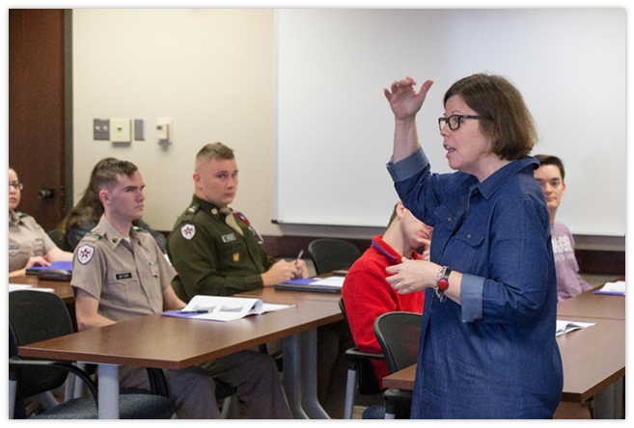
#1: Go to Class!
If you are NOT going to class you are missing something!
It is the #1 strategy for success!
Meet with your professor BEFORE you are having issues.
Make a friend!
Notes:
Information you need is always disseminated in class. Even if you get notes from someone or access the slides on eCampus, you still miss out.
Professors generally know when students have been to class and when they have not, even in a class of hundreds.
Whether attendance is taken or not, there may be quiz points, extra credit opportunities, or even just brownie points with seeing your professor in class every day.
Make a friend because you never know when you will have to miss class and need to share notes.

Slide 12
#2: Be Prepared For Class
Read before you go to class!
If you have questions, write them down.
Study, study, study!
If a professor provides lecture notes, print them off.
Notes:
Reading before class will familiarize you to the material that will be covered, making it easier to understand during lecture or enabling you to identify concepts you find particularly challenging. Prepping for class can also help with focus and note taking. We get distracted when we don’t understand something and will be better at recognizing what’s important if we’re already familiar with the material.
If you have questions about the material covered in the reading, you can pose them in class. Reading might also give you something to talk about during office hours!
Bringing notes with you makes it easier to focus on what the professor is saying rather than what is already provided to you in lecture notes, which leads to tip #3…

Slide 13
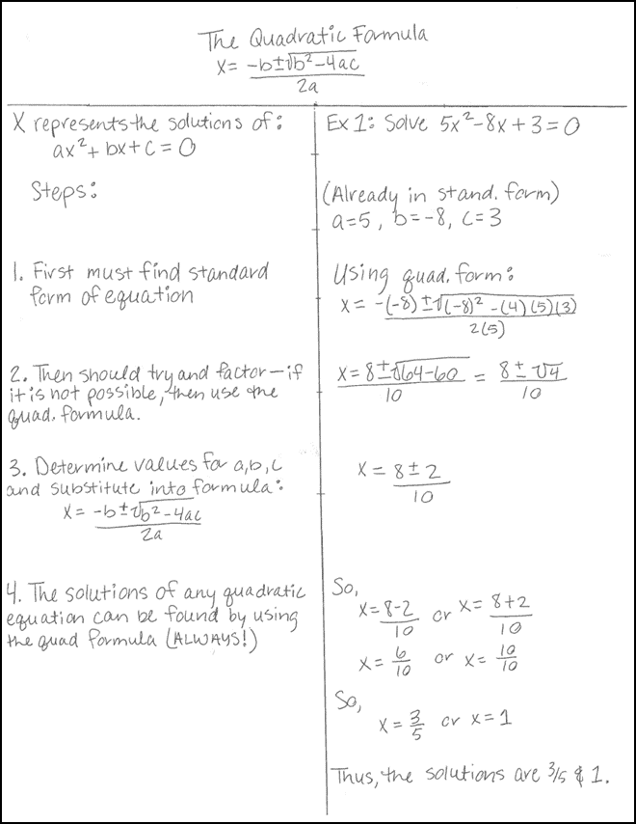
#3: Take Good Notes
Find a good seat and pay attention
Listen actively
Don’t try to write everything down
Ask questions
Use note-taking strategies:
Cornell Notes
Modified Outline
T-Notes
Notes:
Sit more in the first 3-5 rows closer to the professor or in an aisle. It will give you more eye contact with the professor making it easier to pay attention and hear what the professor is saying.
Taking word for word notes is not helpful, try to write things in your own words that will help you recall the information later.
Asking questions and being able to answer them from lecture about the information can help with learning and remembering the processes and context as well as information.
Using different note-taking strategies for different kinds of classes can be helpful with organizing material and make it easier to set up active learning strategies based on the notes later when you start to study.

Slide 14
#4: Implement a Time Management System
Fixed Commitment Calendar, Day Planner, Study Log…
2-3 hours per credit hour
Schedule specific study times for each class
Break up your tasks to fight procrastination
If it doesn’t work for you, try something else!
Notes:
There are many different kinds of time management systems. What is best will vary from person to person, and can actually include more than one system. Just find at least one that works for you. If what you’re doing isn’t working, change it!
It is highly recommended that students schedule 2-3 hours of study time per credit hour they are in class during the week. Students taking 15 credits should schedule between 30-45 study hours per week.
Set specific study times for each class to make sure you’re not extending study time for one class doesn’t come at the expense of another. It’s fine to add study time during busy stretches like exam weeks or for homework-heavy classes, but don’t neglect your other subjects.

Slide 15
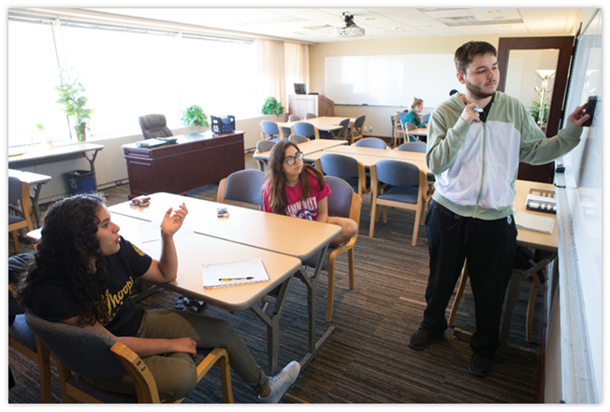
#5: Identify Good Study Environments
Know when you are most alert and what time you are able to study best.
Find a place that is comfortable, but not TOO comfortable!
Limit your external distractions and reduce your internal distractions.
NEVER study in bed!
Notes:
Find a place that is comfortable and where you can stay focused but not too comfortable that you’ll fall asleep. A bed/couch is a prime example that is too comfortable and distracts us to want to go to sleep even if we are trying to actively study.
Also, think of what times in the day you work best and try to study either your more difficult material then or study material you do not necessarily like first to get it out of the way.

Slide 16
#6: Read Actively
Preview/Survey
Create questions to read with a purpose
Avoid “Happy Highlighter Syndrome”
Alternate readings with active study strategies
Ask “Why?” “How?” and “What if?” questions
Notes:
Take a few minutes to introduce yourself to the reading. Quickly scan the text to assess length and note things like visuals, headings, footnotes and charts. Also take stock of what you know about the topic and from this material before you start reading. Check out questions at the end of chapters (if applicable) or pose your own questions and read looking for answers.
Marking texts can break your focus and prohibit you from getting in a high-efficiency, high comprehension zone. If you find yourself distracted or wanting to highlight or note everything, finish sections, paragraphs, or pages before highlighting, underlining, or annotating.
Write out questions to give your reading purpose, especially for classes or readings that you find challenging. Having something to search or actively read for gives you a better chance at comprehension.
Reading is only a part of learning. Alternate reading with reflection and study to maximize how much you’re learning.

Slide 17
#7: Review and Test Yourself
Review your notes every day.
Create and plan a study strategy for each exam.
Develop your own study guides and practice exams.
Use test preparation techniques
Flash cards
Timelines
Comparison charts
Concept Maps
Notes:
Minimize the effects of the forgetting curve off by reviewing notes every day. Reviewing does not have to take up a lot of time; just a little review every day—especially in the first few days after learning something new—makes a big difference.
Reading and reviewing are not studying; use active study strategies to prepare for exams. Try a variety of study strategies like study guides, note cards and concept maps to better prepare for exams. And take practice exams; if instructors don’t post sample exam questions, create your own.
Spend at least 5 days preparing for exams. Break up the material the test covers into four chunks. Schedule time to study each chunk, starting with the oldest material, and reviewing it on the following days. Make a plan for how you will create and use study materials over those five days.

Slide 18
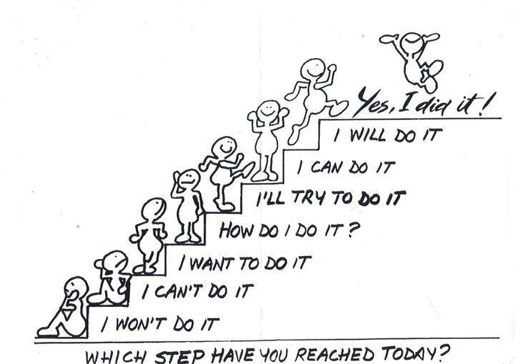
#8: Think Positive
Emotional state can affect learning!
Develop “want to”
Find relevance, value, and importance in any task.
Develop “can do”
Eliminate feelings of self doubt or feelings of frustration.
Setting up SMART goals can make a difference.
Notes:
A&M is a great place to be. Appreciate and maximize your opportunities here. Take care of your health, holistically. Get exercise, eat healthily—these things improve your attitude and the better you feel, the more you’ll learn. See challenges—tests and assignments—as opportunities. Even at the most stressful times, enjoy the shared experience you’re having with your fellow students. Instead of getting bogged down in the immediacy of assignments, keep some perspective on how your work here fits into the larger purpose of your life.
Life happens, however. Sometimes we all get upset, angry, or sad, which makes it hard to learn. Try to compartmentalize personal/internal distractions when it’s time for class or time to study.
If you can’t, Counseling and Psychological Services is available to help.
Knowing why we are doing what we are doing helps us fight procrastination and stay motivated. By setting up SMART (Specific, Measurable, Attainable, Relevant and Timely) goals and developing a “want to” and “can do” attitude helps us get things done and stay on track.

Slide 19
#9: Know Your Resources
Be familiar with academic resources on and off campus.
Use available resources such as:
Academic Success Center
Counseling and Psychological Services
Career Center
University Writing Center
Disability Services
Studyhub.tamu.edu
Your most important resources are your professors and academic advisor.
Notes:
Texas A&M is a very large university with lots of resources available to students. It is important to know where you can go to find help; however, even if you are not sure exactly where to go, go somewhere. Any student support office on campus will be happy to refer you to a different office on campus if it is better suited to help you.
Resources that tend to be underutilized are you professor and your academic advisor. Meeting with your professor helps you problem-solve and stay up to date on what is expected of you in the class. Meeting with your academic advisor keeps you up to date with your degree plan and on track to graduate.

Slide 20
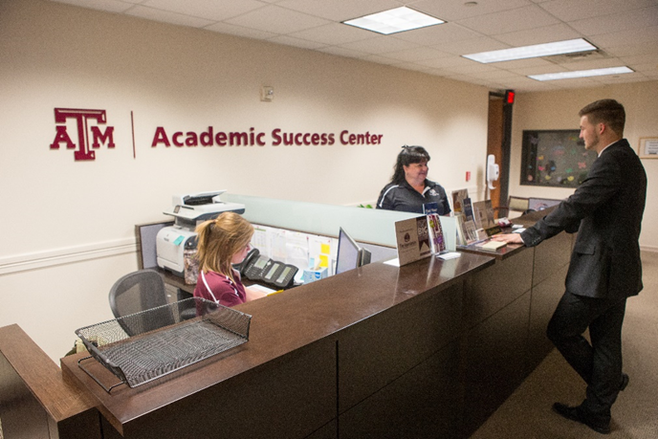
#10: Seek Help
Seek help the moment you begin struggling
Use available resources
Meet with your professors and talk to your academic advisors
Come the Academic Success Center for help and referral.
Notes:
It is one thing to know about the resources, but another to actually use them. College is different from high school in that the focus of responsibility is now on the student rather than the teacher. It is up to you to reach out for help when you need it, so do not be afraid to ask! The moment you find yourself struggling, did not do as well on that test as you had hoped, or just plain don’t know what to do next, the resources at TAMU are here to help.

Slide 21
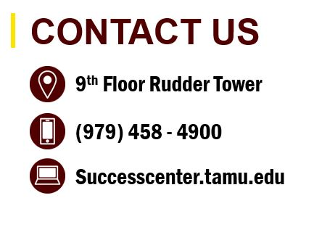
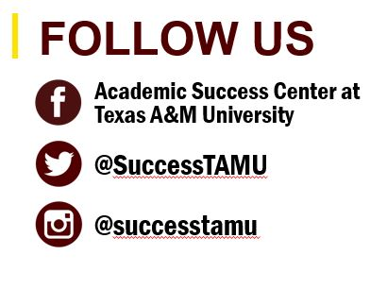
And don’t forget StudyHub.tamu.edu!

