Slide 1
Note-Taking (or maybe better yet, Note-Making)

Slide 2
Taking Good Notes Is Crucial for Academic Success
“Educational research clearly shows that the completeness of lecture notes is positively related to academic achievement.” –Bonnie Armbruster, University of Illinois
All activities associated with note-taking aid in learning:
Listening
Selecting
Interpreting
Discerning
Writing
Reviewing
Studying
Notes:
Armbruster (now deceased) is a widely published author in the field of learning. This quote comes from

Slide 3
Why Take Notes?
Creates a record for study and exam-prep materials
Promotes active learning
Boosts comprehension and retention
Practices prioritizing and organizing information
Increases alertness, focuses attention and extends attention span
Enhances creativity
So, go to class and take your own notes. There’s no substitute!

Slide 4
How to Take Notes
Note-taking involves listening to the teacher, selecting the important information, and writing it down. And, to some extent, discerning what’s important from what’s not is intuitive. Simple, right?
But like most things associated with being a student, you can get better at taking notes with just a little attention to detail and a willingness to experiment, going beyond what comes natural to you to find what helps you learn best.
Fundamentals:
Preview before Class
Focus in Class! Minimize Internal and External Distractions
Implement a System

Slide 5
Take Notes Electronically?
If you take notes on a laptop or iPad, be careful to avoid becoming a transcriber. You don’t have to write down everything your instructor says. In fact, it’s better not to. Think critically about what you include and omit, and take notes in your own words. When you engage in the cognitive process of distilling content and writing it in your own words, you are learning!
Still want to use a laptop or your iPad?
If so, there’s an app for that: https://apps.apple.com/app/apple-store/id778658393

Slide 6
Preview Class Content before Class
Check the Syllabus to See What Will Be Covered in the Upcoming Class
Look Back at Notes from Last Class
Read/Look Over Textbook/Reading Materials that Correspond to Material to be Covered in Class
Previewing makes it easier to:
Discern What’s Important from What’s Not As Important
Know What to Record in Notes
Make Connections to Other Course Material
Stay Focused during Lecture (We lose focus/concentration when we don’t understand something. Previewing makes that less likely.)

Slide 7
Note-Making Systems
Cornell Notes
Outline
Mapping
Flow
T-Notes (for Math)

Slide 8
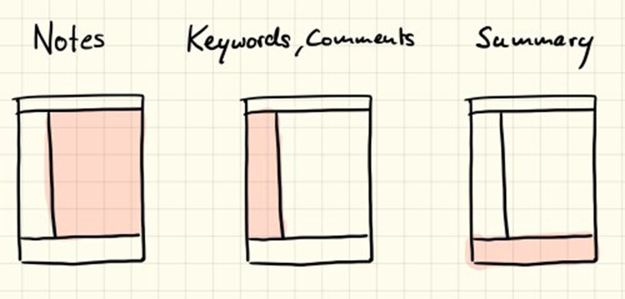
Cornell Method
Reserves Space in Your Notes for Note-Taking in Class and Summarizing/Review/Exam Prep after Class
PROS
Designates Space for:
Cues
Information Triggers
Key Words
Points You Need Clarified
Possible Exam Questions
Comments
Cons
None

Slide 9
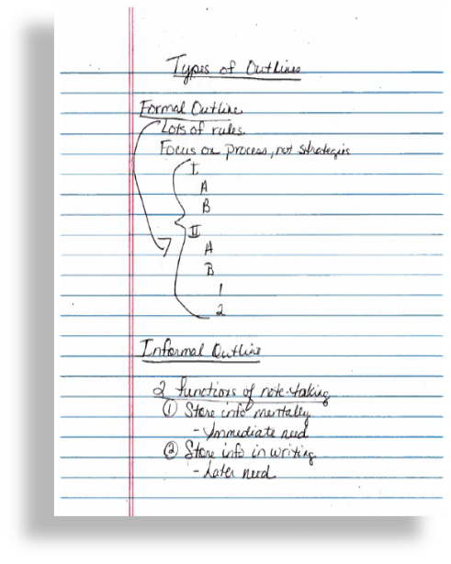
Outline Method
Create a hierarchy of information, with main points in bold on the left hand side of the page and subpoints or examples below and to the right
PROS
Highlights relationships between major points, supporting materials and examples
Makes revision/review easy by presenting information in an order of importance
Could be done electronically
CONS
Requires students to recognize hierarchy of information on the spot

Slide 10
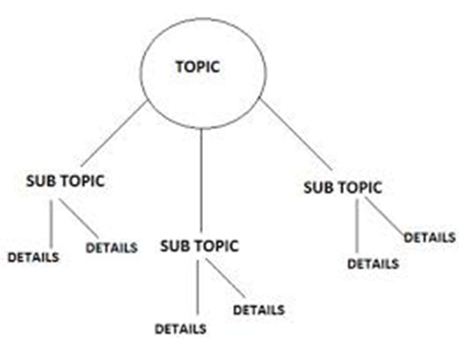
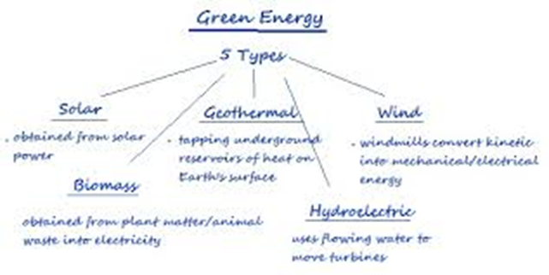
Mapping
A graphic instead of textual representation of the lecture
Start with a central point and sketch related information around it
PROS
Great for visual learners
Encourages Creativity
Helps Make Connections to Related Info
Easy to Edit/Revise and Add Features Like Color-Coding
CONS
Less Complete, Requiring More to Be Added after Class

Slide 11
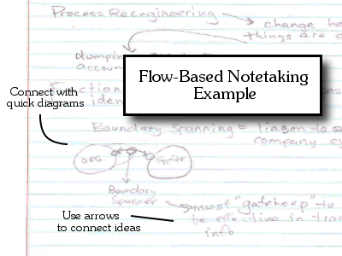
Flow Method
Strive to make your notes a record of how you are processing what’s happening in class, rather than a transcript of class.
The flow method is similar to mapping, except that you make a document reflecting how you are thinking about class content, including your own connections or examples.
Highlight the most important points
Write down what you are thinking about the material; don’t worry about how the material is being presented
Create something original, not a facsimile of class
Focus on your ideas as you learn the material, not the lecturer’s

Slide 12
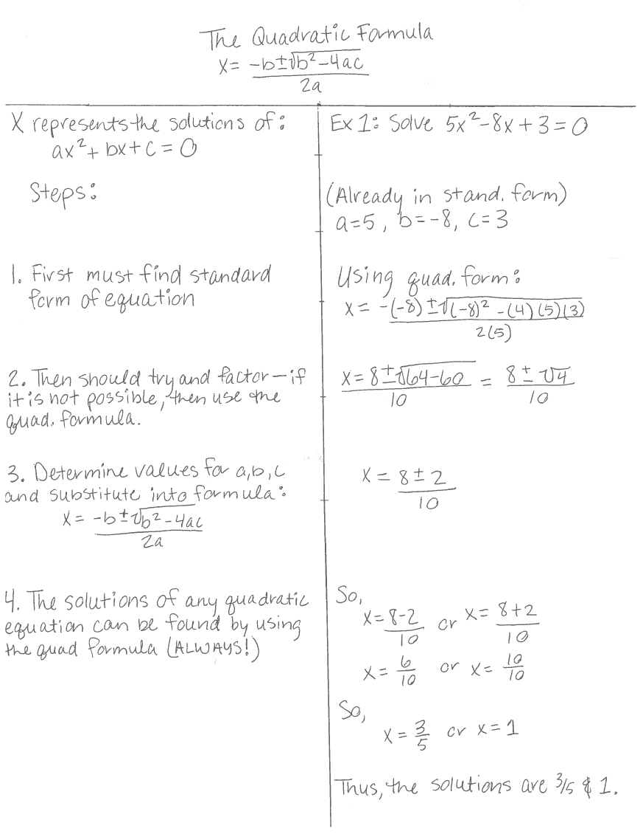
T-Notes
(for problem-based material)
T-Notes can help you understand the process behind a concept, as well as, help you identify where you need clarification.
Problem and/or Concept
Work the Problem | Explain each step
Draw a “T” on your note paper
Write down the problem or concept at the top
In the left column, work the problem, showing each step
In the right column, write down the steps for solving the problem, explaining why each step is necessary

Slide 13
In Class
Make Your Notes Review-Ready
Date Your Notes
Use Headings
Write in Phrases
Develop Your Own Shorthand
Try to Identify Main Points, Supporting Details and Examples
Note When the Instructor Emphasizes Concepts
(i.e. Repetition, Pauses, Summary, Statements of Importance, etc.)
Be Prepared to Focus
Bring the Materials You Need
Sit Up Front
Don’t Show Up Tired, Distracted, Hungry or Thirsty If You Can Help It
Leave Outside-of-Class Concerns at the Door
Refocus When Your Mind Wanders

Slide 14
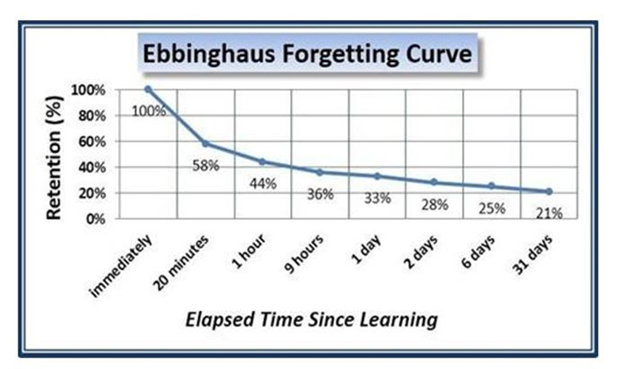
After Class
Do something with your notes
Complete
Edit
Revise
Convert to study materials
Speculate about what problems or exam questions your instructor could create based on this content
Find answers to anything you have questions about or need clarification on; email or visit your instructor if necessary.
IMPORTANT
REVIEW YOUR NOTES to stay ahead of the Curve

Slide 15


Final Tips
Go to class; the act of making notes contributes to the learning process
Focus in class; work to eliminate internal and external distractions
Write in your own words. Be interpretive; don’t try to write everything down. You aren’t a transcriber.
Implement a system that works for you (even if it’s your own
Do something with your notes within 24 hours after class (edit/review/clarify/convert to study materials)
Compare your notes to a classmate’s

