Slide 1
Preparing for Exams
Presenter’s name and title

Slide 2
Overview
Information Processing
Why Cramming Doesn’t Work
A Better Approach to Learning
Exam-Prep Strategies
5-Day Study Plan
Studying for More Than One Exam at a Time
Post-Test Analysis

Slide 3
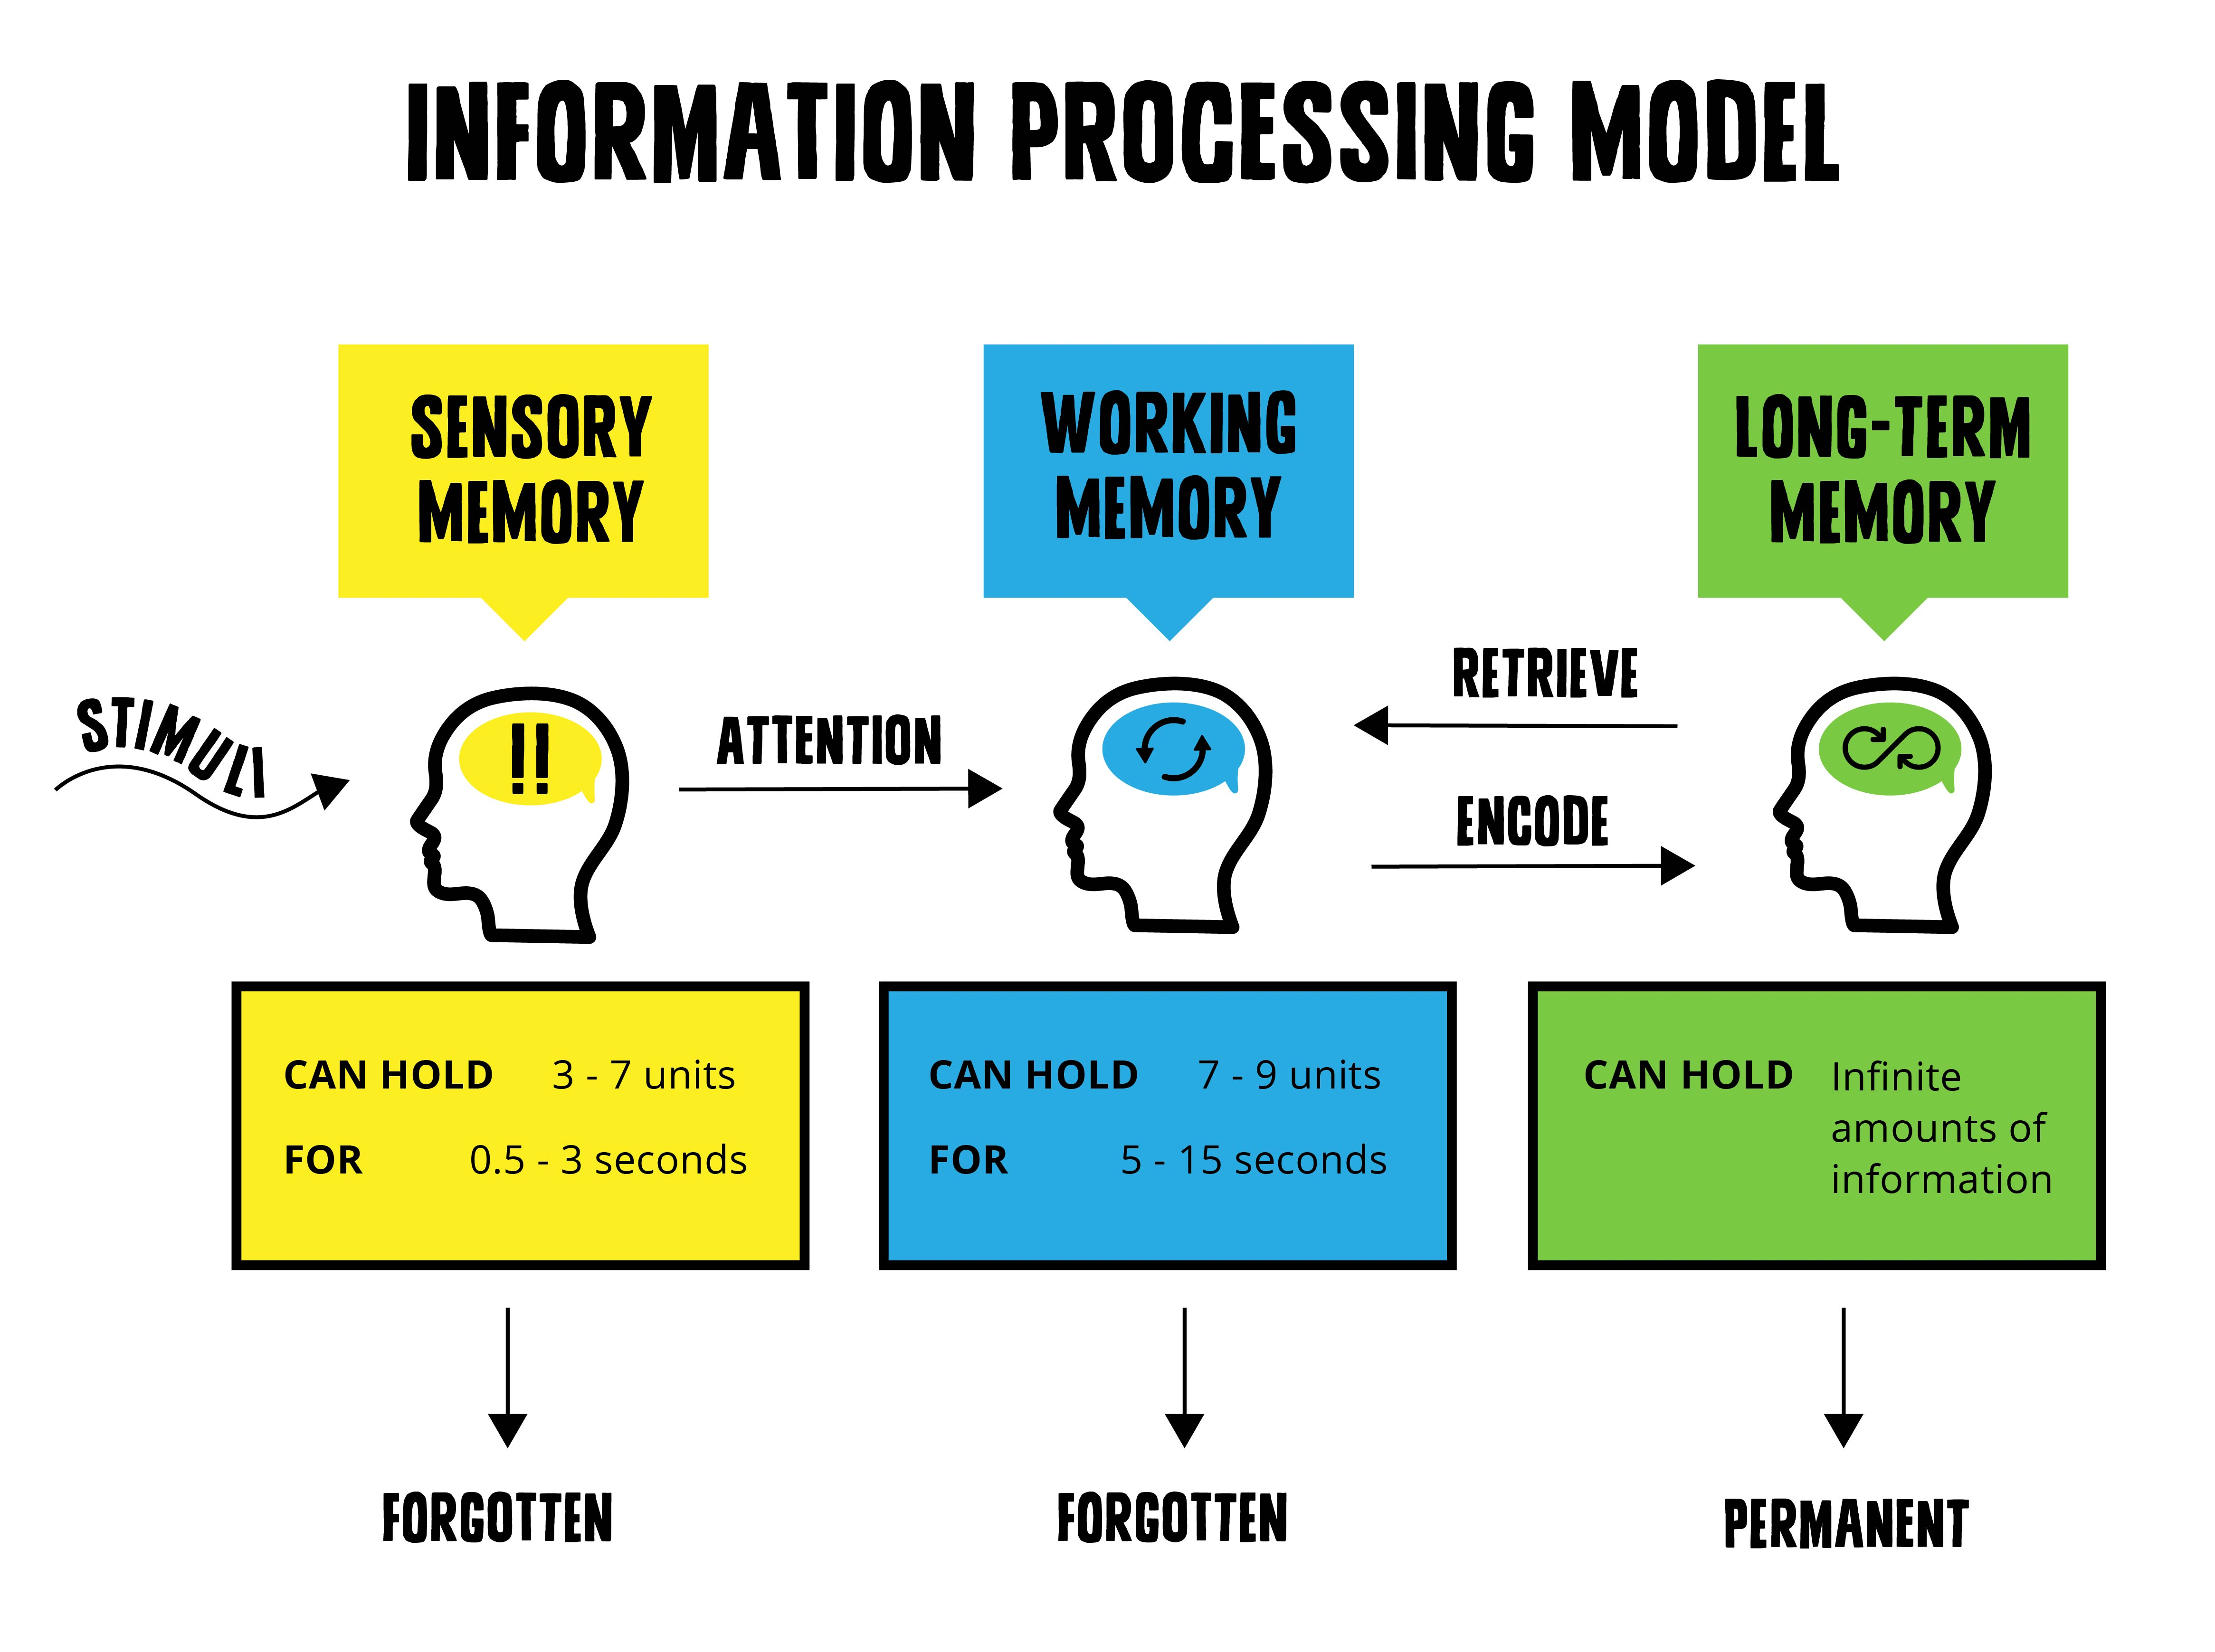
How Our Brains Process Information
See
Taste
Hear
Touch
Smell

Slide 4
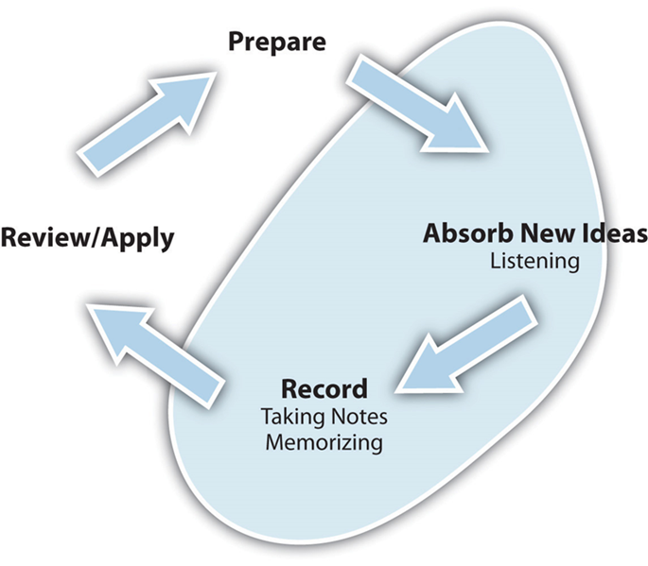
Follow a Consistent Approach to Learning
Learning is a process. Adopt the process and avoid cramming!
Prepare before class
Focus in class
Take good notes
Review/Practice/Study after class

Slide 5
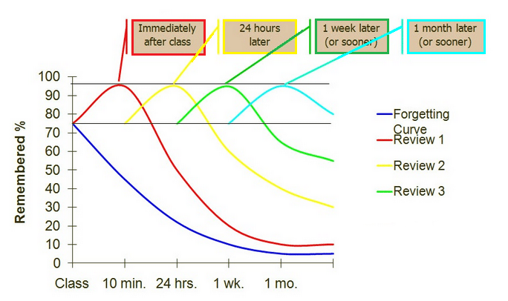
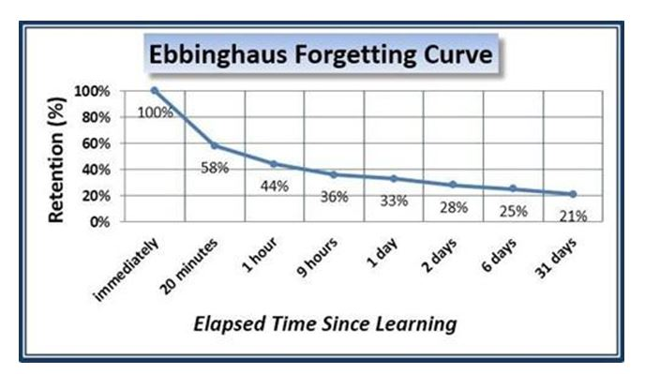
Avoid Forgetting What You Learn
Preview before class
Review after

Slide 6
Study Actively
Reviewing helps avoid the forgetting curve, but studying should consist of more than just review
Look at the course learning outcomes and study for the level of learning at which you’re expected to perform
Convert your notes into test prep materials that help you learn at the intended levels
Study with purpose each study session

Slide 7
Active Learning/Test Prep Materials
Develop study sheets
Develop concept maps
Make flashcards (word, question, formula, problem)
Do study guides
Create a hierarchy or flowchart or Venn diagram
Make and define a list of 20, 30, 40 topics that would be on the exam
Do problems (w/o looking up steps)
Outline
Summarize material
Chart related material
List steps in the process (timeline)
Predict/plan/write essay questions and answers
Answer questions at the end of the chapter
Prepare material for study group

Slide 8
Make a Study Plan
The TAMU Academic Success Center recommends making a five-day study plan (these need not be consecutive days).
Plan out your schedule and amount of time to study (days and hours)
Divide material covered on the exam into four segments
Start with the oldest information first
Proceed by systematically studying and reviewing
Employ Specific Make/Use strategies
Self-test

Slide 9
5-Day Study Plan
Day 1
Prepare/Make 1st chunk, 2 hrs
Day 2
Prepare/Make 2nd chunk, 2 hrs
Review/Use 1st chunk, 30 mins
Day 3
Prepare/Make 3rd chunk, 1 ½ hrs
Review/Use 2nd chunk, 30 mins
Review/Use 1st chunk, 15 mins
Day 4
Prepare/Make 4th chunk, 1 ½ hrs
Review/Use 3rd chunk, 30 mins
Review/Use 2nd chunk, 20 mins
Review/Use 1st chunk, 10 mins
Day 5
Review/Use 4th chunk, 30 mins
Review/Use 3rd chunk, 20 mins
Review/Use 2nd chunk, 10 mins
Review/Use 1st chunk, 10 mins
SELF-TEST, 1 hour
Notes:
Self-Tests are one of the most effective ways to learn
Create your own test questions
If your instructors post sample questions or old tests, use those
GOAL for Self-Tests are to determine what you already know and what concepts you do not feel as confident in. To use your time efficiently, you want to work with the material you do not know at a ratio of 2:1 or 3:1.

Slide 10
Multiple Exams at Once
One Test
Two Tests
Three Tests, Four
 | Sun | Mon | Tues | Wed | Thurs | Fri | Sat | Sun | Mon | Tues
 | POLS Day 1 | POLS Day 2 | POLS Day 3 | POLS Day 4 | POLS Day 5 | POLS Exam
 | Sun | Mon | Tues | Wed | Thurs | Fri | Sat | Sun | Mon | Tues
 | POLS Day 1 | POLS Day 2 | POLS Day 3 | POLS Day 4 | POLS Day 5 | POLS Exam
 |  | MATH Day 1 | MATH Day 2 | MATH Day 3 |  | MATH Day 4 | MATH Day 5 | MATH Day 6 | MATH EXAM
 | Sun | Mon | Tues | Wed | Thurs | Fri | Sat | Sun | Mon | Tues
 | POLS Day 1 | POLS Day 2 | POLS Day 3 | POLS Day 4 | POLS Day 5 | POLS Exam
 |  | MATH Day 1 | MATH Day 2 | MATH Day 3 | MATH Day 4 |  | MATH Day 5 | MATH Day 6 | MATH EXAM
 |  |  |  | PSYC Day 1 | PSYC Day 2 | PSYC Day 3 | PSYC Day 4 | PSYC Day 5 | PSYC EXAM
 | CHEM Day1 |  | CHEM Day 2 |  | CHEM Day 3 | CHEM Day 4 | CHEM Day 5 | CHEM Day 6 | CHEM Day 7 | CHEM EXAM
Notes:
Showing variety of lengths based on difficulty

Slide 11
Minimize Test Anxiety
Before the exam:
Establish a good study routine throughout the semester, so you don’t have to pack all your learning into the days before an exam.
Know the logistical info on exam day. What do you need to bring? Where do you go? What time?
Get plenty of sleep the night before, eat well, and give yourself plenty of time so you don’t have to rush. Avoid outside stress.
Avoid others who are anxious.
During the exam:
Survey the test before you try to answer any questions.
Remind yourself to relax and use relaxation strategies.
Avoid doubt by answering questions you know first. Don’t linger too long on questions you don’t know
Focus on your test; don’t worry about what others are doing

Slide 12
After the Exam
Engage in a Post-Test Analysis.
Figure out what active strategies of learning worked and those that did not.
You must have access to your exam to perform a meaningful Post-Test Analysis.
(Note: If you do not get the exam back, then go to office hours to review the questions. Even if your exam is returned to you, it is still wise to go to office hours to discuss the exam with your professor.)

Slide 13
Post-Test Analysis
Some questions to ask yourself (and possibly the professor)
Where did the questions come from… Book? Lecture?
Did I spend enough time studying? When did I start? Did I CRAM or spread it out?
What types of questions did I miss? Is there a pattern to it?
Did I make careless errors… Marked the wrong bubble? Misread the question?
How can I change my approach (i.e. learning strategies) to the material in order to do better next time?

Slide 14
Goal of Post-Test Analysis
Each exam should be considered a learning opportunity for you to determine what adjustments need to be made for future Exam Preparation.
The underlying concepts of Post-Test Analysis can easily be applied to papers, projects, and presentations. Incorporate feedback provided to know what changes to make in the future.
(Again… If no feedback is spontaneously provided, go to office hours to talk to your professor about the assignment and any recommendations for the future.)

