Slide 1
Bloom’s Taxonomy
Notes:
Bloom’s Taxonomy of Educational Objectives was created in 1956 by Benjamin Bloom, who was at the time working as an educational psychologist for the University of Chicago Board of Examiners. He chaired a committee tasked with developing a categorized list of educational outcomes. Bloom’s Taxonomy has been immeasurably influential in k-12 and higher education.

Slide 2
Bloom’s and Higher Education
Bloom’s theories of learning influence the creation of learning objectives/outcomes instructors create for courses
Instructors design curriculum, conduct instruction, and create assessment to help students achieve the desired learning levels for the courses they teach based on Bloom’s Taxonomy
Look at your course syllabi to see how Bloom’s Taxonomy shapes your course
Use the learning objectives on your syllabus and Bloom’s Taxonomy to set your own expectations for yourself
Notes:
Bloom’s influences the creation of learning objectives in higher education, as well as designing of curriculum and assessment. It is important for students to become familiar with these levels of learning. Students should be able to identify the levels at which they are expected to perform academically by looking at the course learning objectives. And they should design study materials and self-test at this level.

Slide 3
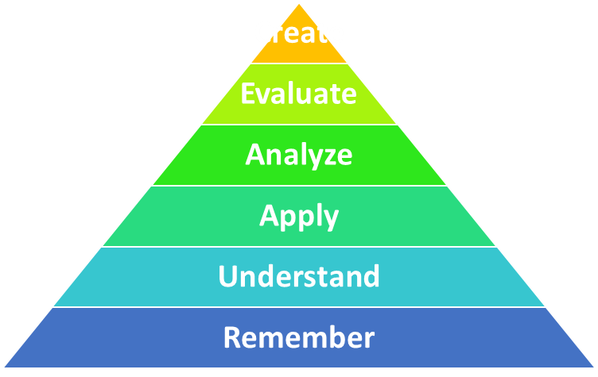
What Is It?
Bloom’s Taxonomy is a visual and descriptive representation of learning levels
Starts at the bottom with foundational knowledge, such as the basic recall of facts and concepts, and moves upward toward more higher-level measures of learning
Conceptualized as a pyramid
Foundational learning is at the bottom
Higher-order learning as you go up
Notes:
The triangle diagram showing how learning progresses through 6 levels of increasingly higher orders of learning. This doesn’t mean that the top levels are more important than the bottom. They are all important.

Slide 4
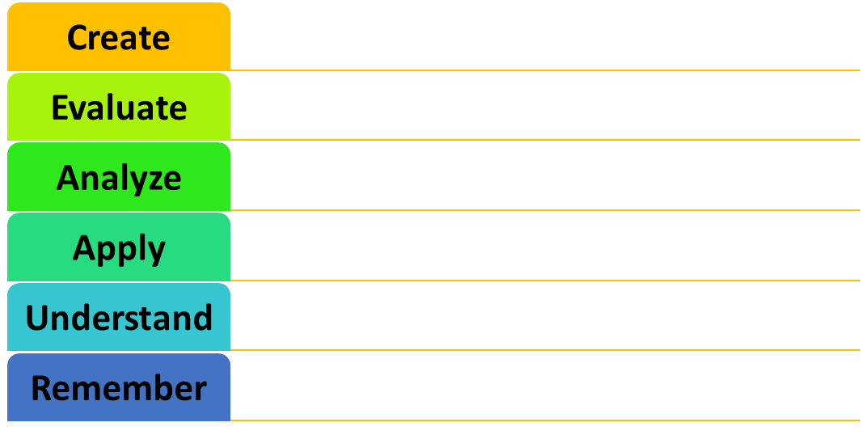


Learning Levels
Combining parts to make a new whole
Build, combine, formulate, devise, change, adapt, construct, produce
Judging the value of information or ideas
Validate, justify, critique, rate, prioritize, select, assess, monitor
Higher-order Levels
Breaking down information into basic parts
Classify, divide, differentiate, research, discover, simplify, dissect
Applying the facts, rules, concepts, and ideas
Practice, implement, develop, solve, generalize, operate, plan
Understanding what the facts mean
Discuss, paraphrase, interpret, outline, review, summarize, organize
Fundamental Levels
Recognizing and recalling facts
Define, list, name, recognize, match, choose, show, find
Notes:
While students may have been exposed to some advanced levels of learning, high school and “introductory” courses in college are designed to ensure that students have at least mastered the fundamental levels (remember and understand) so they can work through the higher levels of learning as they progress through their major course of study

Slide 5
Remember
Recalling facts and basic concepts—the most fundamental of all learning levels
Essential to higher-level learning
The key is to store this information in long-term memory
Can you identify/list/order/outline/recall the basic who/what/when/where?
To store information in long-term memory, categorize items or use mnemonics
Examples:
Can you remember math formulas? Recite a poem? List the 50 states? Name the state capitals?
Notes:
Remembering and understanding (in the next slide) are fundamental, but that doesn’t mean they’re easier to learn or less important than the other levels. In fact, they might be the most important. Students can’t perform at higher levels until they’ve learned the basics. Moreover, even upper level classes may have knowledge/understanding questions on exams. Exams are often designed with knowledge questions in an opening section before transitioning to application, analysis, or evaluation.

Slide 6
Understand
Ok, so now you can recall basic facts and concepts, but do you understand?
Understanding enables you to:
give meaning to the information/content by discussing/expressing/explaining/summarizing/interpreting
predict consequences or effects
make connections to other material/information
Examples:
Can you explain the formula or the items in the formula, interpret a poem or summarize a process?
Notes:
Understanding involves interpretation and explanation of knowledge. More than just knowing facts or concepts, students should be able to articulate, describe, discuss, explain, extrapolate, paraphrase, and summarize. At this level, you are making meaning of what you know.

Slide 7
Apply
The application level is the first in which you are required to do something with what you’ve learned.
You apply the concepts, methods, rules, laws, or theories to a particular, concrete, or hypothetical situation.
Examples:
Can you predict an outcome based on current and shifting conditions? Solve problems using formulas? Conduct an experiment?
Notes:
Application is higher-order learning. This is the first level in which students are required to do something with what they’ve learned—implement, execute or carry out a procedure.

Slide 8
Analyze
When conducting an analysis, you break down a whole into its component parts so that you may better understand how it works, is structured, or how its parts are related.
At this level, you can think critically about ideas, concepts, texts to ascertain hidden meaning or motives, or to differentiate between fact and opinion or sound logic and fallacy.
Examples:
Classify an unidentified animal given a list of its characteristics? Why did trade conflicts between China and the UK lead to the Opium Wars? What makes the Gettysburg address so effective?
Notes:
To analyze is to break something into its constituent parts to better understand the relationship of its parts to each other, its purpose or implications, how it works, or its biases and influences.

Slide 9
Evaluate
Evaluation refers to the act of judging something for a given purpose.
Judgments should be made using criteria that students create or are given.
Evaluation requires all other Bloom’s levels except creation.
Examples:
Ascertain which procedure should be used to treat a patient experiencing a specific set of symptoms?
Determine which investment strategy might produce higher yield.
Make a judgment about an ethical dilemma.
Notes:
Evaluation is near the top of the Bloom’s pyramid because making informed and sound judgments about anything involves exercising learning at all preceding levels.

Slide 10
Create
Creation involves putting elements together in a new form, pattern or structure, or creating a new whole. What is created could be new products, ideas or perspectives
Examples
Invent a machine to solve a problem
Design an environmentally-conscious office building
Devise a new way to perform spine surgery
Compose an original piece of music or literature
Create a plan to address a social problem
Notes:
Creation of new knowledge, perspectives, ideas or products is one of the chief responsibilities of higher education. By definition, to do research is take what we know in the present and advance it. Professors are evaluated on their ability to advance knowledge through research.

Slide 11
Bloom’s Levels of Learning Applied to Goldilocks and the Three Bears
REMEMBER - Recall the items used by Goldilocks while she was in the Bears house.
UNDERSTAND - Explain why Goldilocks liked Baby Bear’s porridge, chair, and bed the best.
APPLY - Predict what Goldilocks would use if she came to your house.
ANALYZE – Think critically about context and question assumptions: Is it plausible that the bears could eat porridge out of bowls? (This is how we discover that there’s more to the story than what happens literally.)
EVALUATE - Judge whether Goldilocks was good or bad. Defend your opinion, but also consider why someone might believe the opposite.
CREATE - Create a new story about Goldilocks that tackles different themes or raises other questions about values.
From Teach Students How to Learn, McGuire (2015)
Notes:
We’ve inverted the levels from the triangle in this slide, starting with “Remember” at the top since it should be discussed first. The purpose of this exercise is to illustrate the levels of Bloom’s in a way that will give students confidence in recognizing them. Most everyone remembers the story of Goldilocks and the Three Bears. If not, a refresher would only take a minute. Goldilocks goes for a walk, comes upon a house, goes in, chooses one of three bowls of porridge, chairs to sit in, and beds to lie in. The bears come home to discover her activities and she runs away. This is an exercise Saundra McGuire uses in her 2015 book, Teach Students How to Learn.

Slide 12
Introductory BIOL textbook end of chapter questions organized by Bloom’s level.
Notes:
Here, we can see how the construction of a textbook is influenced by Bloom’s. The end-of-chapter questions are informed by Bloom’s levels of learning.

Slide 13
Final Tips
Assess the level of learning required in your classes by looking at the syllabus, as well as from homework, practice problems, examples in class, end of chapter reviews, etc.
Pay attention to the level of learning at which you are studying
Study at levels HIGHER than homework levels! Often, college exams test you at higher levels than class discussion and homework.
Expect concepts to be combined or modified on an exam
Problems-based courses are particularly sensitive to working through the bottom learning levels first. You have to memorize steps before you can combine concepts

