Slide 1
Reading for Success in College

Slide 2
Consider the following processes:
Jen was planning a trip to Europe and needed to get a passport. She drove to the local passport office, got in line, and waited. When it was her turn, she explained to the clerk what she was there for. The clerk asked her if she had filled out a DS-11 form, and if she had her driver’s license, proof of citizenship, passport photo, and a check or money order. Sarah did not have proof of citizenship, a passport photo, or a checkbook with her, and she hadn’t filled out a DS-11 form. The clerk gave her the DS-11 form, but informed her that she would have to bring all the other items with her in order to get a passport. Sarah asked where to get a passport photo. The clerk explained that she could get a passport photo taken at a UPS store or Walgreen’s or other similar businesses. Sarah went and had a passport photo made, then gathered all the documents she needed and a checkbook, then returned to the passport office the next day. She submitted everything, got her passport in the mail six weeks later, and off to Europe she went.
Notes:
Slides 2, 3, and 4 present two hypotheticals intended to show that preparation leads to better success and efficiency. The same goes for academic reading.

Slide 3
Next…
Veronica was planning a trip to Europe and needed to get a passport. She opened www.usa.gov/passport on her internet browser to see what all she would need before going to a passport office. She saw that she would need a completed DS-11 form, a driver’s license, proof of citizenship, a passport photo, and a checkbook. She researched where to get a passport photo, gathered her materials, and went to get her photo made. Once she had the photo, she went to the passport office to request a passport. She received a passport in the mail six weeks later and off to Europe she went.

Slide 4
Assess
Whose approach was better, Jen’s or Veronica’s?

Slide 5

Reading for Fun
It’s a choice!
Selected by interest
Done at your own pace
Concentration and/or focus needed can vary
Can do at bedtime
Notes:
It’s important to distinguish between reading for fun and reading for school. Not that reading for school can’t be fun, but it’s also work. Slides 5 and 6 highlight this distinction in order to help students understand that reading for school can’t be approached in the same way as reading for fun.

Slide 6

Academic Reading
Implement a plan -- Before starting to read, preview the text and consider context, ask questions and set a purpose
Read intently, giving the text your undivided attention
Reading for Comprehension
Answer questions, summarize, discuss and use active study strategies

Slide 7
Types of College Reading
Textbooks
Supplemental
Additional Assigned Readings
Research

Slide 8
What to do with Textbooks
Your syllabus schedule will list what will be covered in each class. In general, what will be covered in class corresponds to a chapter or chapters in a textbook.
If this is the case, read this material before class. Doing so will help you:
Start the learning process
Make connections to what you already know
Stay focused during lecture
Ask questions
You might also read to clarify anything you were unclear about during lecture or as part of your exam preparation.
Notes:
Reading material that corresponds to a lecture before that lecture is one of the keys to learning effectively. Previewing before class and reviewing after is the best way to learn and make better grades than cramming. Reading before a lecture is also the best way to stay on top of your schoolwork rather than working from behind.

Slide 9
Supplemental Reading
Take charge of your own learning!
Supplemental reading can help:
Provide a greater understanding of course material
Understand the larger context
Notes:
Your professors may also list supplemental or suggested readings on the syllabus or mention them in class. Learning in college takes place primarily outside of class. Your professors and the University expect you to move beyond what goes on in class and become a self-starting learner.

Slide 10
Additional Assigned Reading
You may be assigned other readings for an in-class exercise, an out-of-class assignment or project, or an exam. Your instructor should make clear what your purpose is in completing these readings.

Slide 11
Managing Reading Time
Schedule time for assigned and supplemental reading; obviously, you’ll prioritize graded work, but reading for class is something you will be tested on eventually. So, even if you don’t have a test/quiz on what you’re reading tomorrow or this week, it’s still important you do it.
Find a time and setting that fosters concentration and focus, which are critical for comprehension.

Slide 12
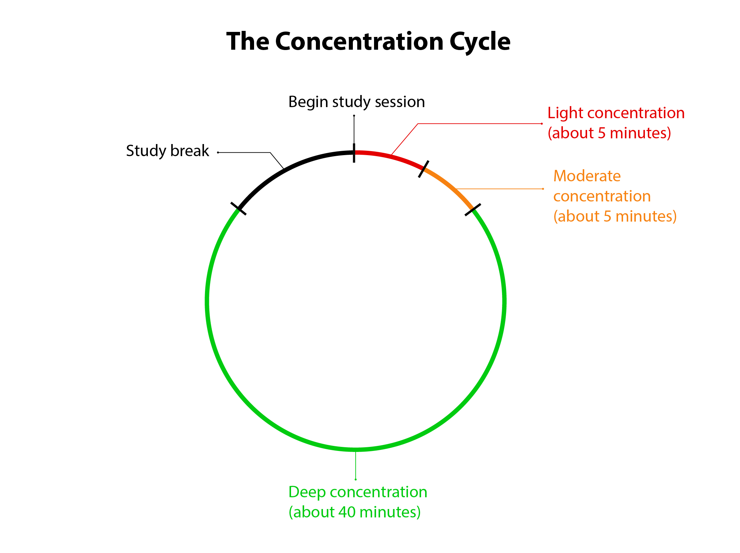
Get in the Zone
Become aware of when and where you read most effectively, as well as for how long
Remove distractions
Notes:
Schedule study time in one hour blocks. Start by getting organized and setting a purpose for your session. After beginning to concentrate fully, most of us can focus intensely for only 30-50 minutes at a time before we get to the point of distraction or at least diminishing returns. In order to stay efficient, take a break. Do something totally unrelated to your study activity. If you’ve been using a computer, get away from the screen. If you’ve been using pen and paper, it’s okay to check email, social media, or whatever. Taking a walk is the best option, though. Your brain takes physical cues. When you sit down at a desk, your brain should know it’s time to work. Conversely, when you stand up and start moving, your brain will know it’s break time.

Slide 13
Academic Reading Processes
SQ3R/SQ4R
Survey
Question
Read
Record
Recite
Review
KWL
Know
Want to Know
Learn
Notes:
SQ4R and KWL are two widely accepted and prescribed reading systems students might try. Both promote previewing a text before beginning to read, reading actively, recording what you read, and reviewing it afterwards.

Slide 14
Active Reading – Ways to Enhance Retention
Annotating/Highlighting
Summarizing
Outlining
Notes:
Break readings into manageable chunks. Read, then annotate. Annotating while you read can interrupt your focus.

Slide 15
Annotating/Highlighting
Number paragraphs
Divide the text into chunks
Read an entire chunk before marking
Underline, highlight, make notes, ask questions, make connections with purpose and via a system
Avoid over-annotating (Do not be a happy highlighter.)

Slide 16
Artifacts – Making a Record of What You Read
Answer chapter-end questions
Take practice tests
Define key terms
Incorporate information from the reading into your notes
Create study materials
Notes:
Different options for making notes on—or processing—what you’ve read.

Slide 17
Takeaways
Read!
Locate places where you can read effectively
Implement a strategy, at least preparing before you begin, setting a purpose, reading actively, and reviewing

